Slide 1
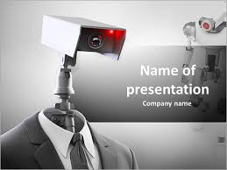
HOME SURVEILLANCE ROBOT

Slide 2

CAPSTONE PROJECT MEMBERS
THIPPESWAMY N
UMESHA P
APOORVA RT

Slide 3
CONTENTS
ABSTRACTS
INTRODUCTION
PROBLEM STATEMENT
LITRATURE REVIEW
BLOCK DIAGRAM
METHODOLOGY
HARDWARE AND SOFTWARE REQUIRED
HARDWARE DISCRIPTION
APPLICATIONS
ADVANTAGES
RESULT AND CONCLUTION

Slide 4
ABSTRACT
The main goal behind this project is to create a robot that will perform indoor surveillance.
Today, robots play an important role in our daily life, reducing manual labour and human error.
The purpose of the robot is to walk around, collect audio and visual information from the environment and transmit the received information to the user.
In this project, people can control the robot via Internet of Things (IoT) with the help of mobile devices or laptops and use a wireless camera for the robot to receive Streaming video day and night.

Slide 5
INTRODUCTION
Surveillance robot is the robot used for the surveillance purpose.
This project describes a new financial system for robotic systems.
The robot is controlled by a wired network. Programming the robot takes time and needs to be reprogrammed in case of changes in the project. Therefore, they are not user friendly and work with user preferences.
It is designed to perform the tasks commanded by the user in order to make the robot user-friendly And to have a say in the control of the robot. To do this, modern technology must be used.
To use today's technology, every user must know how to use it. To achieve and meet all these needs, we use Android phone as a multimedia, user-friendly device to control the robot.

Slide 6
PROBLEM STATEMENT
All electronic devices that we use today are based on embedded systems technology, where the processors of such a system play a very important role.
Problem of the work can be stated as “ Designing the robot with sensory device, Wi-Fi controlling , programming the systems to recognaize and to track the robot using GPS “.
The main aim is to design and implement Wi-Fi based controlling the robot, with front end wheels help it to take left and right turns and rear end wheels to move forward and reverse.
Creating a data base of objects in the environment, by capturing images of the object.
Person/object recognition using Neural Network and tracking the robot using GPS.

Slide 7
LITERATURE REVIEW
There are many documents in the literature on the design and implementation of wireless mobile robots and inspection robots, some of which are discussed below:
Novandri et al. Get. The design and use of a self-defence robot guard against a nail gun is shown. Also, the robot can transmit audio and video files using the Wi-Fi protocol.
Surendra et al. Get. A video surveillance robot is designed for surveillance purposes. The robot can detect human movements. They found a low-cost four-wheeled clock robot using an Arduino microcontroller and ZigBee technology. This system is very good especially for monitoring in areas without internet.

Slide 8
Pradeep et al. Get. The mobile robot is designed to detect pollution and send its value to the user by usingATMega2560 microcontroller, gas sensor, Wi-Fi and GSM modules.
Objective
To investigate wireless technologies for machine-human interaction.
The creation of a home surveillance robot for security purposes.
Create an android system capable of managing electrical equipment

Slide 9
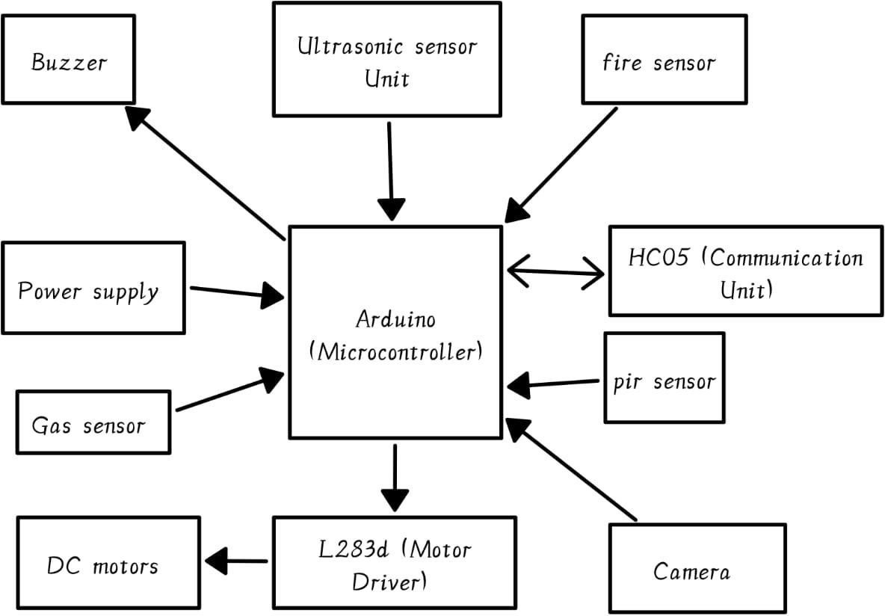
BLOCK DIAGRAM

Slide 10
METHODOLOGY
Define requirements
Supportive Operating systems for server
Supportive Operating systems for client
Software requirements
Design system
The system consists of two major sections – one is the user section and other is the robot section.
In that the user section can possess laptop or mobile for communicating with the robot end. Thus by using a laptop or a mobile the user section can be a portable one compared to those that uses a typical stationary computer systems.
Develop and integrate subsystems
The subsystem should be developed and integrated into the overall system.
This involves designing the mechanical components. Developing the software , and integrating the various subsystems into a cohesive system.

Slide 11
Test and validate the system
Functional testing
Accuracy testing
Noise testing
Sensitivity testing
Range testing
Securitytesting
Etc
Deploy and maintain the system
The final step is to deploy the robot and maintain it over time. This involves ensuring that the robot remains operational and meets the needs of the surviellance, as well as updating the system as needed to incorporative new technologies and capabilities.

Slide 12
HARDWARE AND SOFTWARE REQUIERMENTS
HARDWARE REQUIERMENTS
Arduino uno
MotordriverL293D
Ultrasonic sensor
Infrared sensor
PIR sensor
Gas sensor
Camera module
HC 05Bluetooth module
Robot chassis
L clamp
Wheels
SOFTWARE REQUIERMENTS
Arduino IDE
C++

Slide 13
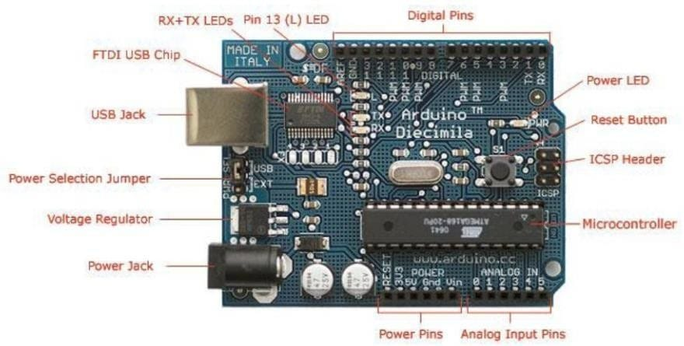
ARDUINO UNO
Description
IC: Microchip ATmega328P[9] Clock Speed: 16 MHz on Uno board, though IC is capable of 20MHz maximum at 5 Volts Flash Memory: 32 KB, of which 0.5 KB used by the bootloader SRAM: 2 KB EEPROM: 1 KB USART peripherals: 1 (Arduino software default configures USART as a 8N1 UART) I2C peripherals: 1 Operating Voltage: 5 Volts Digital I/O Pins: 14 PWM Pins: 6 (Pin # 3, 5, 6, 9, 10 and 11)[11] Analog Input Pins: 6 DC Current per I/O Pin: 20 mA DC Current for 3.3V Pin: 50 mA

Slide 14
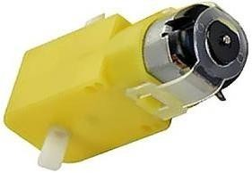
DC Gear Motor
Specification :- Operating Voltage (VDC) : 3 ~ 12V Shaft Length (mm) : 8.5 Shaft Diameter (mm) : 5.5 No Load Current (mA) : 40-180mA. Rated Speed After Reduction (RPM) : 100 Rated Torque (Kg-Cm) : 0.35 Weight (gm) : 30 Dimensions in mm (LxWxH) : 70x35x22 Gearbox Shape : Straight

Slide 15
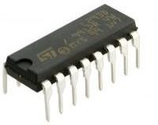
L293D Motor Driver
DESCRIPTION
The Robotics uses the L293D Motor Driver IC which utilizes two H- Bridges to control the speed and motion of the respective motors. It features of16 pins that can be used to control two motors.
It Consists of two input pins and two output pins for each motor, and the input is received from the Micro-computer and the output goes to the motor.
Wide Supply-Voltage Range: 4.5 V to 36 V Separate Input-Logic Supply Internal ESD Protection High-Noise-Immunity Inputs Output Current 1 A Per Channel (600 mA for L293D) Peak Output Current 2 A Per Channel (1.2 A for L293D)

Slide 16
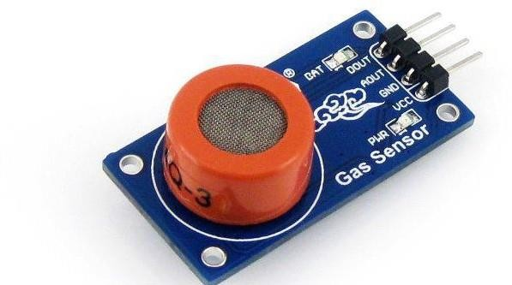
Mq3 Gas Sensor
DESCRIPTION
It is a sensor which can detect the presence of various flammable gases at different concentrations.
The output of the sensors varies according to the presence of gas values.

Slide 17
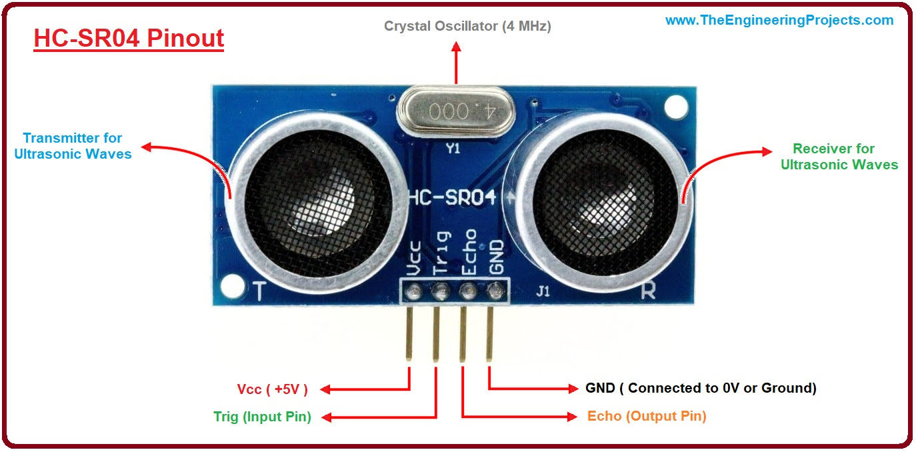
HC-Sr04 Ultrasonic sensor
DESCRIPTION
HC-SR04 is an ultrasonic sensor mainly used to determine the distance of the target object.
It measures accurate distance using a non-contact technology
Transmitter and receiver are two main parts of the sensor where former converts an electrical signal to ultrasonic waves while later converts that ultrasonic signals back to electrical signals.

Slide 18
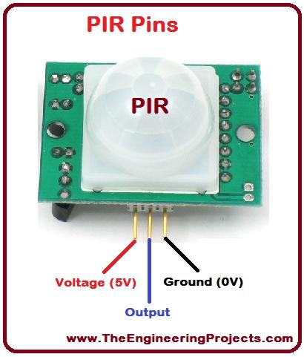
HC-SR501 Passive Infrared (PIR) Motion Sensor
DESCRIPTION
This sensor is used to detect motion of any obstacle or presence of any body.
The range of the sensor varies from 3-7m.

Slide 19
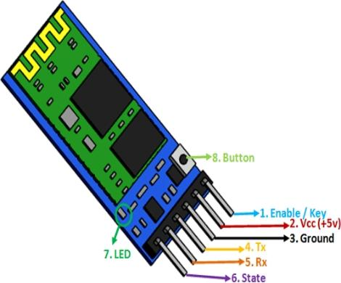
HC-05 Bluetooth Module
Features: Bluetooth v2.0+EDR 2.4GHz ISM band frequency Supported baud rate: 9600 (default), 19200,38400, 57600, 115200, 230400, 460800. Speed: Asynchronous: 2.1Mbps(Max) / 160 kbps, Synchronous: 1Mbps/1Mbps Power supply: 3.6V to 6V DC Passkey: 1234

Slide 20
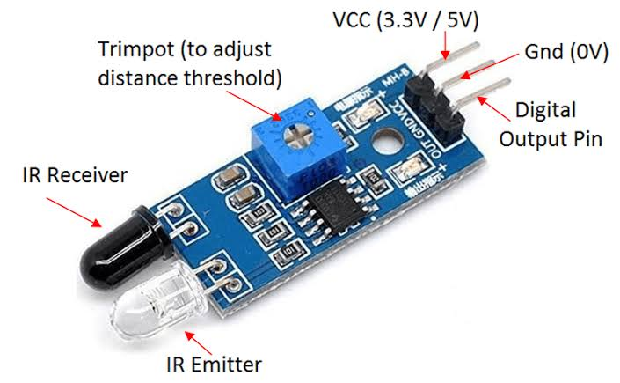
Ir sensor
DESCRIPTION
An infrared proximity sensor or IR Sensor is an electronic device that emits infrared lights to sense some aspect of the surroundings and can be employed to detect the motion of an object.
The working of the IR sensor module is very simple, it consists of two main components: the first is the IR transmitter section and the second is the IR receiver section. In the transmitter section, IR led is used and in the receiver section, a photodiode is used to receive infrared signal and after some signal processing and conditioning, you will get the output.

Slide 21
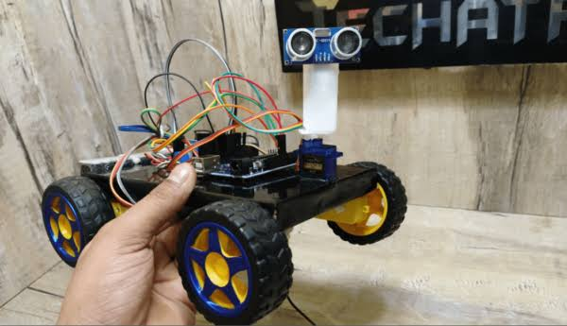
advantages
There are several advantages to having a home surveillance robot, which can provide enhanced security and peace of mind for home owners. Some of the key advantages include:
Remote Monitoring
Enhanced Security
Deterrence
Mobility and Flexibility
Interactivity and Communication
Convenience and Time-saving
Integration with Smart Home Systems
Peace of Mind

Slide 22
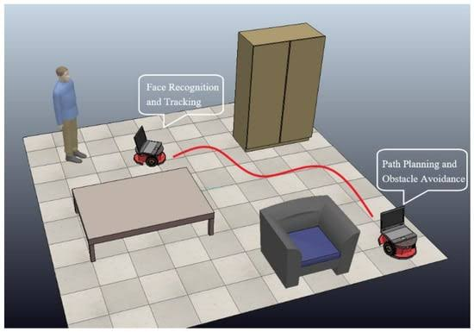
applications
Home surveillance robots can have various applications in enhancing home security and providing convenient monitoring solutions. Some of the key applications of home surveillance robots include:
Intrusion Detection
Video Surveillance:
Remote Monitoring:
Emergency Response
Interaction and Communication:
Automation and Integration:
Pet Monitoring:
Elderly Care:

Slide 23
Result and conclusion
In conclusion, the prototype home surveillance robot project has the potential to provide significant advantages in terms of home security, convenience, and peace of mind.
Through the development and testing of a working proto type, the project has demonstrated the feasibility and functionality of a home surveillance robot that can perform tasks such as remote monitoring, video surveillance, intrusion detection, and automation features.

Slide 24


